Slide 1
Design Patterns

Slide 2
Design Patterns
In software engineering, a design pattern is a general reusable solution to a commonly occurring problem in software design.

Slide 3
Design Patterns
Creational Patterns
Structural Patterns
Adapter, Bridge, Decorator
Behavioral Patterns
Strategy, Template
Concurrency Patterns

Slide 4
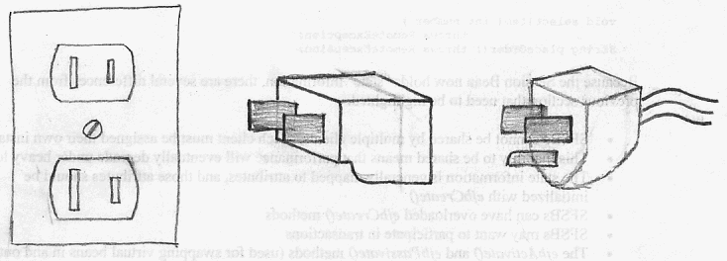
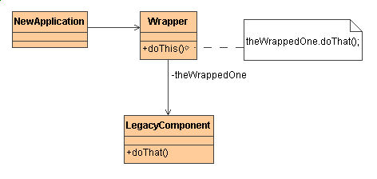
Structural Patterns:
Adapter (Wrapper, a type of proxy)

Slide 5
#include <iostream.h>
typedef int Coordinate;
typedef int Dimension;
//////////////////////// Desired interface ////////////////////////
class Rectangle { public: virtual void draw() = 0; };
//////////////////////// Legacy component ////////////////////////
class LegacyRectangle {
public:
LegacyRectangle( Coordinate x1, Coordinate y1, Coordinate x2, Coordinate y2 )
{ x1_ = x1; y1_ = y1; x2_ = x2; y2_ = y2;
cout << "LegacyRectangle: create. (" << x1_ << "," << y1_ << ") => (" << x2_ << ",” << y2_ << ")" << endl; }
void oldDraw()
{ cout << "LegacyRectangle: oldDraw. (" << x1_ << "," << y1_ << ") => (" << x2_ << "," << y2_ << ")" << endl; }
private:
Coordinate x1_; Coordinate y1_; Coordinate x2_; Coordinate y2_;
};

Slide 6
////////////////// Adapter wrapper //////////////////
class RectangleAdapter : public Rectangle, private LegacyRectangle {
public:
RectangleAdapter( Coordinate x, Coordinate y, Dimension w, Dimension h ) : LegacyRectangle( x, y, x+w, y+h )
{ cout << "RectangleAdapter: create. (" << x << "," << y << "), width = " << w << ", height = " << h << endl; }
virtual void draw()
{ cout << "RectangleAdapter: draw." << endl;
oldDraw(); }
};
void main()
{ Rectangle* r = new RectangleAdapter( 120, 200, 60, 40 );
r->draw(); }
// LegacyRectangle: create. (120,200) => (180,240)
// RectangleAdapter: create. (120,200), width = 60, height = 40
// RectangleAdapter: draw.
// LegacyRectangle: oldDraw. (120,200) => (180,240)

Slide 7
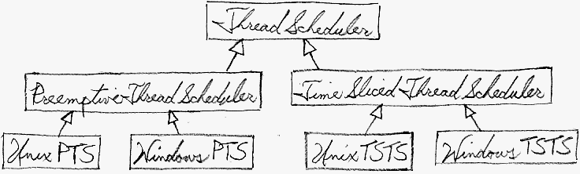
Structural Patterns:
Bridge

Slide 8
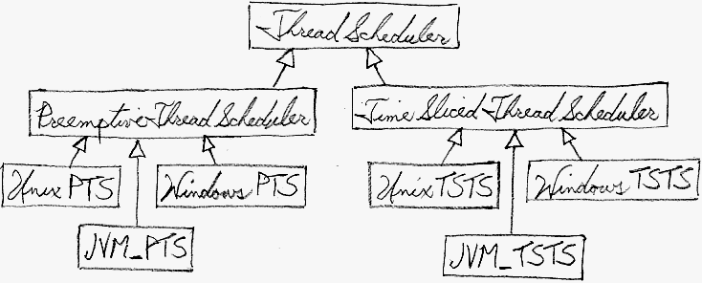
Structural Patterns:
Bridge

Slide 9
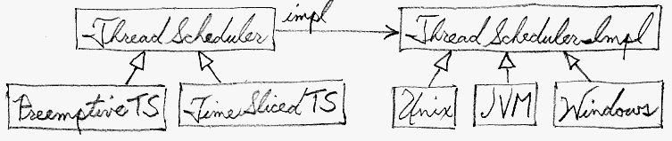
Structural Patterns:
Bridge

Slide 10
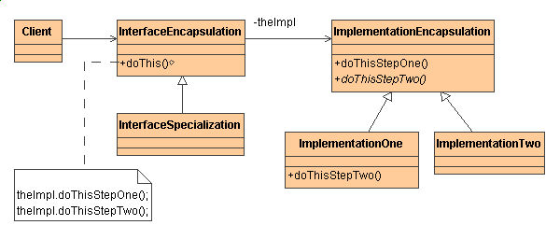
Structural Patterns:
Bridge (another type of proxy)

Slide 11
Use the Bridge pattern when:
you want run-time binding of the implementation,
you have a proliferation of classes resulting from a coupled interface and numerous implementations,
you want to share an implementation among multiple objects,
you need to map orthogonal class hierarchies.
Consequences include:
decoupling the object's interface,
improved extensibility
hiding details from clients.

Slide 12
#include <iostream.h>
#include <iomanip.h>
#include <string.h>
class TimeImp {
public:
TimeImp( int hr, int min ) { hr_ = hr; min_ = min; }
virtual void tell()
{ cout << "time is " << setw(2) << setfill(48) << hr_ << min_ << endl; }
protected:
int hr_, min_;
};
class CivilianTimeImp : public TimeImp {
public:
CivilianTimeImp( int hr, int min, int pm ) : TimeImp( hr, min )
{ if (pm) strcpy( whichM_, " PM" ); else strcpy( whichM_, " AM" ); }
/* virtual */ void tell() { cout << "time is " << hr_ << ":" << min_ << whichM_ << endl; }
protected:
char whichM_[4];
};
class ZuluTimeImp : public TimeImp {
public:
ZuluTimeImp( int hr, int min, int zone ) : TimeImp( hr, min )
{ if (zone == 5) strcpy( zone_, " Eastern Standard Time" ); else if (zone == 6) strcpy( zone_, " Central Standard Time" ); }
/* virtual */ void tell() { cout << "time is " << setw(2) << setfill(48) << hr_ << min_ << zone_ << endl; }
protected:
char zone_[30];
};

Slide 13
class Time {
public:
Time() { }
Time( int hr, int min ) {imp_ = new TimeImp( hr, min ); }
virtual void tell() {imp_->tell(); }
Protected:
TimeImp* imp_;
};
class CivilianTime : public Time {
public:
CivilianTime( int hr, int min, int pm ) {imp_ = new CivilianTimeImp( hr, min, pm ); }
};
class ZuluTime : public Time {
public:
ZuluTime( int hr, int min, int zone ) {imp_ = new ZuluTimeImp( hr, min, zone ); }
};
void main()
{ Time* times[3];
times[0] = new Time( 14, 30 ); times[1] = new CivilianTime( 2, 30, 1 ); times[2] = new ZuluTime( 14, 30, 6 );
for (int i=0; i < 3; i++)
times[i]->tell();
}
// time is 1430
// time is 2:30 PM
// time is 1430 Central Standard Time

Slide 14
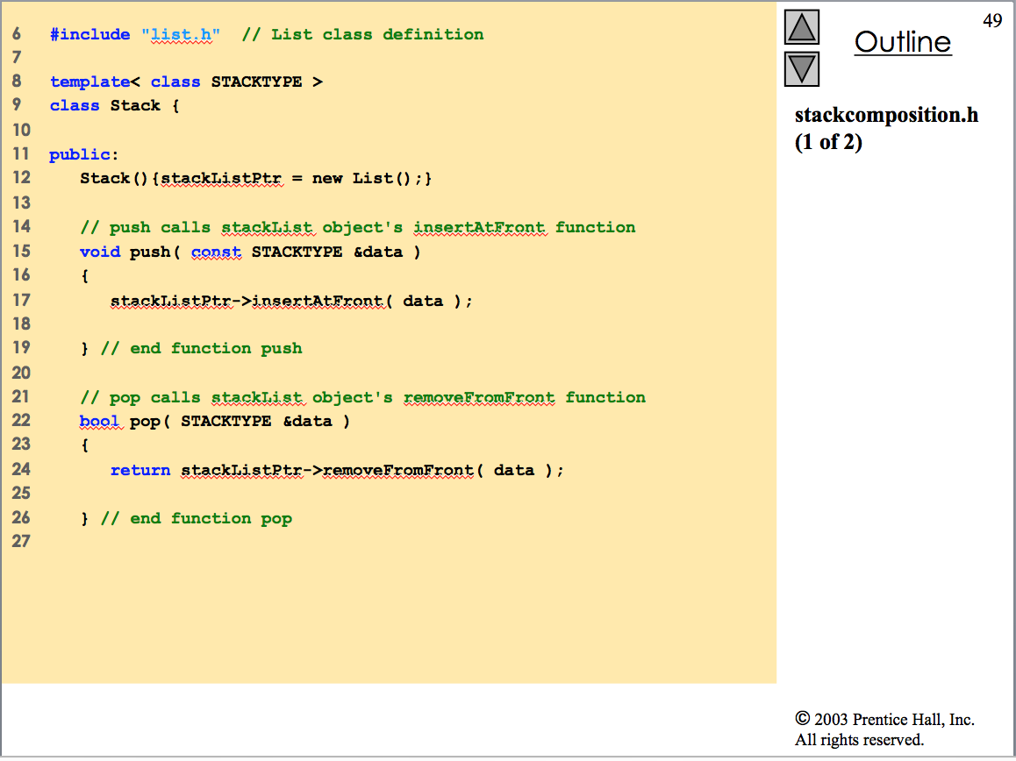

Slide 15
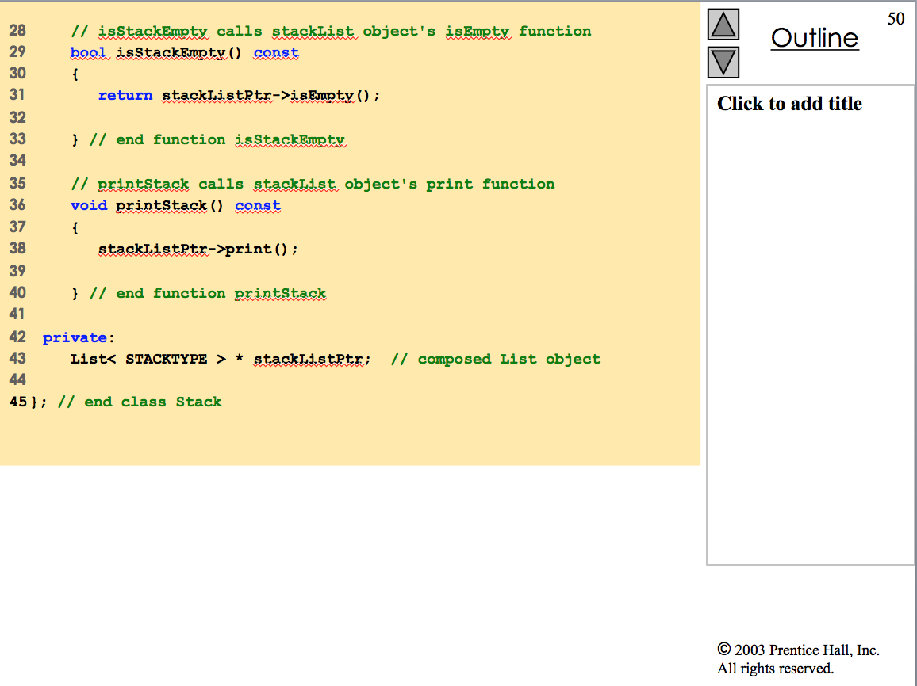

Slide 16
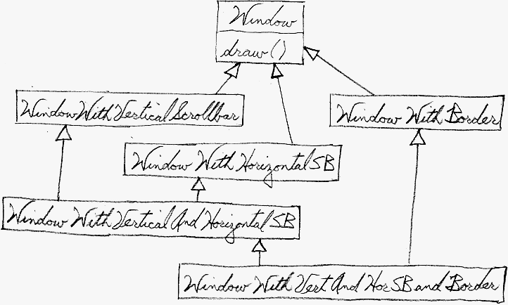
Structural Patterns:
Decorator

Slide 17
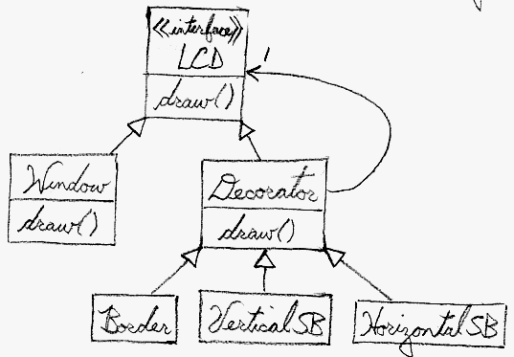
Structural Patterns:
Decorator

Slide 18
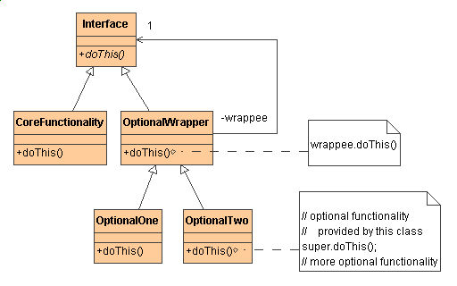
Structural Patterns:
Decorator

Slide 19
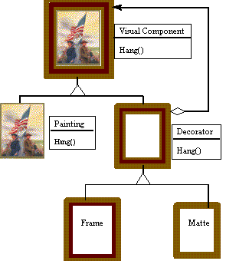
Structural Patterns:
Decorator

Slide 20
#include <iostream>
using namespace std;
class Widget { public: virtual void draw() = 0; }; // 1. "lowest common denom"
class TextField : public Widget { // 3. "Core" class & "isa"
int width, height;
public:
TextField( int w, int h ) { width = w; height = h; }
/*virtual*/ void draw()
{ cout << "TextField: " << width << ", " << height << '\n'; }
}; // 2. 2nd level base class
class Decorator : public Widget { // 3. "isa" relationship
Widget* wid; // 4. "hasa" relationship
public:
Decorator( Widget* w ) { wid = w; }
/*virtual*/ void draw() { wid->draw(); } // 5. Delegation
};

Slide 21
class BorderDecorator : public Decorator {
public: // 6. Optional embellishment
BorderDecorator( Widget* w ) : Decorator( w ) { }
/*virtual*/ void draw()
{ Decorator::draw(); // 7. Delegate to base class
cout << " BorderDecorator" << '\n'; // and add extra stuff
} };
class ScrollDecorator : public Decorator {
public: // 6. Optional embellishment
ScrollDecorator( Widget* w ) : Decorator( w ) { }
/*virtual*/ void draw()
{ Decorator::draw(); // 7. Delegate to base class
cout << " ScrollDecorator" << '\n'; // and add extra stuff
} };
void main( void ) { // 8. Client has the responsibility to compose desired configurations
Widget* aWidget = new BorderDecorator(
new BorderDecorator(
new ScrollDecorator(
new TextField( 80, 24 ))));
aWidget->draw(); }
// TextField: 80, 24
// ScrollDecorator
// BorderDecorator
// BorderDecorator
BorderDec
BorderDec
ScrollDec
TextField
w
w
w
w, h

Slide 22
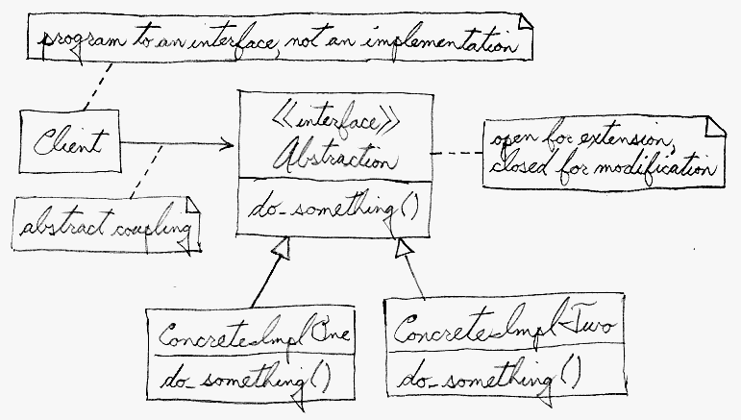
Behavioral Patterns:
Strategy

Slide 23
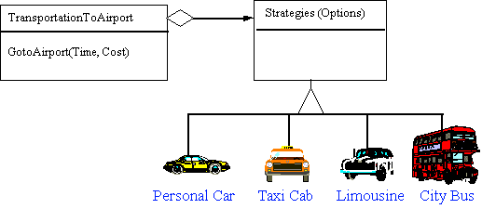
Behavioral Patterns:
Strategy

Slide 24
class SortImpl {
public: virtual void sort( int[], int ) = 0;
};
class SortBubble : public SortImpl {
public:
void sort( int v[], int n ) {
...
class SortShell: public SortImpl {
public:
void sort( int v[], int n ) {
...

Slide 25
class Stat {
public:
Stat() { m_impl = new SortBubble; }
void upGrade() { delete m_impl; m_impl = new SortShell; }
void downGrade() { delete m_impl; m_impl = new SortBubble; }
void readVector( int v[], int n )
{ m_impl->sort( v, n );
m_min = v[0]; m_max = v[n-1]; m_median = v[n/2]; }
int getMin() { return m_min; }
int getMax() { return m_max; }
int getMedian() { return m_median; }
private:
int m_min, m_max, m_median;
SortImpl* m_impl;
};

Slide 26
int main( void ) {
const int NUM = 9;
int array1[NUM], array2[NUM];
srand( time(0) );
cout << "Vector: ";
for (int i=0; i < NUM; ++i)
{ array1[i] = array2[i] = rand() % 9 + 1; cout << array1[i] << ' '; }
cout << '\n';
Stat obj;
obj.upGrade();
obj.readVector( array1, NUM );
cout << "min is " << obj.getMin() << ", max is " << obj.getMax() << ", median is " << obj.getMedian() << '\n';
obj.downGrade();
obj.readVector( array2, NUM );
cout << "min is " << obj.getMin() << ", max is " << obj.getMax() << ", median is " << obj.getMedian() << '\n';
}
// Vector: 7 4 2 6 5 7 7 5 1
// Shell: 1 2 4 5 5 6 7 7 7
// min is 1, max is 7, median is 5
// Bubble: 1 2 4 5 5 6 7 7 7
// min is 1, max is 7, median is 5

Slide 27
template<typename STRATEGY>
class Stat {
public:
void readVector( int v[], int n )
{ m_impl.sort( v, n );
m_min = v[0]; m_max = v[n-1]; m_median = v[n/2]; }
...
private:
STRATEGY m_impl;
};
class SortBubble {
void sort( int v[], int n ) {
...
class SortShell {
void sort( int v[], int n ) {
...

Slide 28
int main( void ) {
const int NUM = 9;
int array[NUM];
srand( time(0) );
cout << "Vector: ";
for (int i=0; i < NUM; ++i) { array[i] = rand() % 9 + 1; cout << array[i] << ' '; }
cout << '\n';
Stat<SortBubble> one;
one.readVector( array, NUM );
cout << "min is " << one.getMin() << ", max is " << one.getMax() << ", median is " << one.getMedian() << '\n';
Stat<SortShell> two;
two.readVector( array, NUM );
cout << "min is " << two.getMin() << ", max is " << two.getMax() << ", median is " << two.getMedian() << '\n';
}
// Vector: 8 3 1 9 7 2 2 9 7
// Bubble: 1 2 2 3 7 7 8 9 9
// min is 1, max is 9, median is 7
// Shell: 1 2 2 3 7 7 8 9 9
// min is 1, max is 9, median is 7

Slide 29
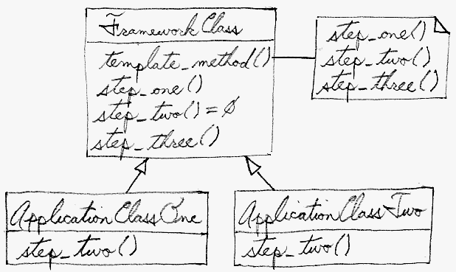
Behavioral Patterns:
Template

Slide 30
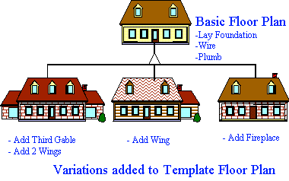
Behavioral Patterns:
Template

Slide 31
#include <iostream>
using namespace std;
class Base {
void a() { cout << "a "; }
void c() { cout << "c "; }
void e() { cout << "e "; }
// 2. Steps requiring peculiar implementations are "placeholders" in base class
virtual void ph1() = 0;
virtual void ph2() = 0;
public:
// 1. Standardize the skeleton of an algorithm in a base class "template method"
void execute() { a(); ph1(); c(); ph2(); e(); }
};
class One : public Base {
// 3. Derived classes implement placeholder methods
/*virtual*/ void ph1() { cout << "b "; }
/*virtual*/ void ph2() { cout << "d "; }
};
class Two : public Base {
/*virtual*/ void ph1() { cout << "2 "; }
/*virtual*/ void ph2() { cout << "4 "; }
};

Slide 32
void main( void ) {
One obj_1;
Two obj_2;
Base* array[] = { &obj_1, &obj_2 };
for (int i=0; i < 2; i++)
{ array[i]->execute(); cout << '\n'; }
}
// a b c d e
// a 2 c 4 e

